Slide 1
Linear relationships
EQ – How do I solve linear equations?
Mrs James
Year 10

Slide 2
In your Cornell Notes glue in the two video note-taking worksheet
You will use this worksheets to collect notes on how to solve equations
You will then be given 5-10 mins in class to create a summary of your notes
https://www.youtube.com/watch?v=l3XzepN03KQ (Solving equations using addition and subtraction)
https://www.youtube.com/watch?v=Qyd_v3DGzTM (Solving equations using multiplication and division)

Slide 3
24
7
30
Date
Linear relationships
EQ – How do I solve linear equations?
Equations are algebraic sentences that can be solved to give a numerical solution.
Equations are solved by undoing any operation that has been performed on the pronumeral.
When solving two-step equations, the reverse order of operations must be applied.
That is: address addition and subtraction first, then multiplication and division, then exponents and roots and, lastly, any bracketed numbers.
Notes:
Input

Slide 4
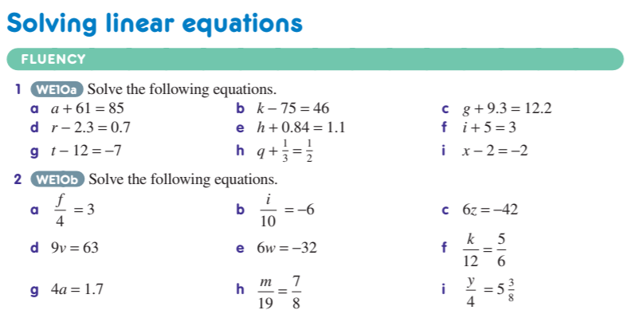
This is where you will need to work independently. GIVE YOUR 100%
I’ll do the first one in each set for you
One-step equations

Slide 5
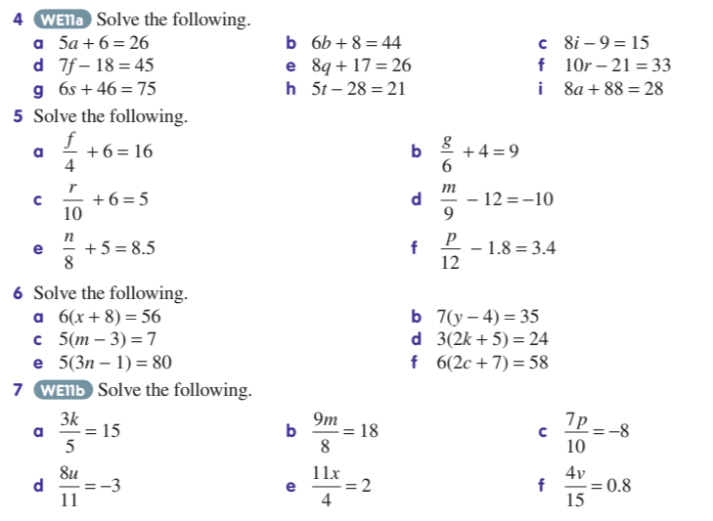
This is where you will need to work independently. GIVE YOUR 100%
I’ll do the first one in each set for you
Two-step equations

